Slide 1
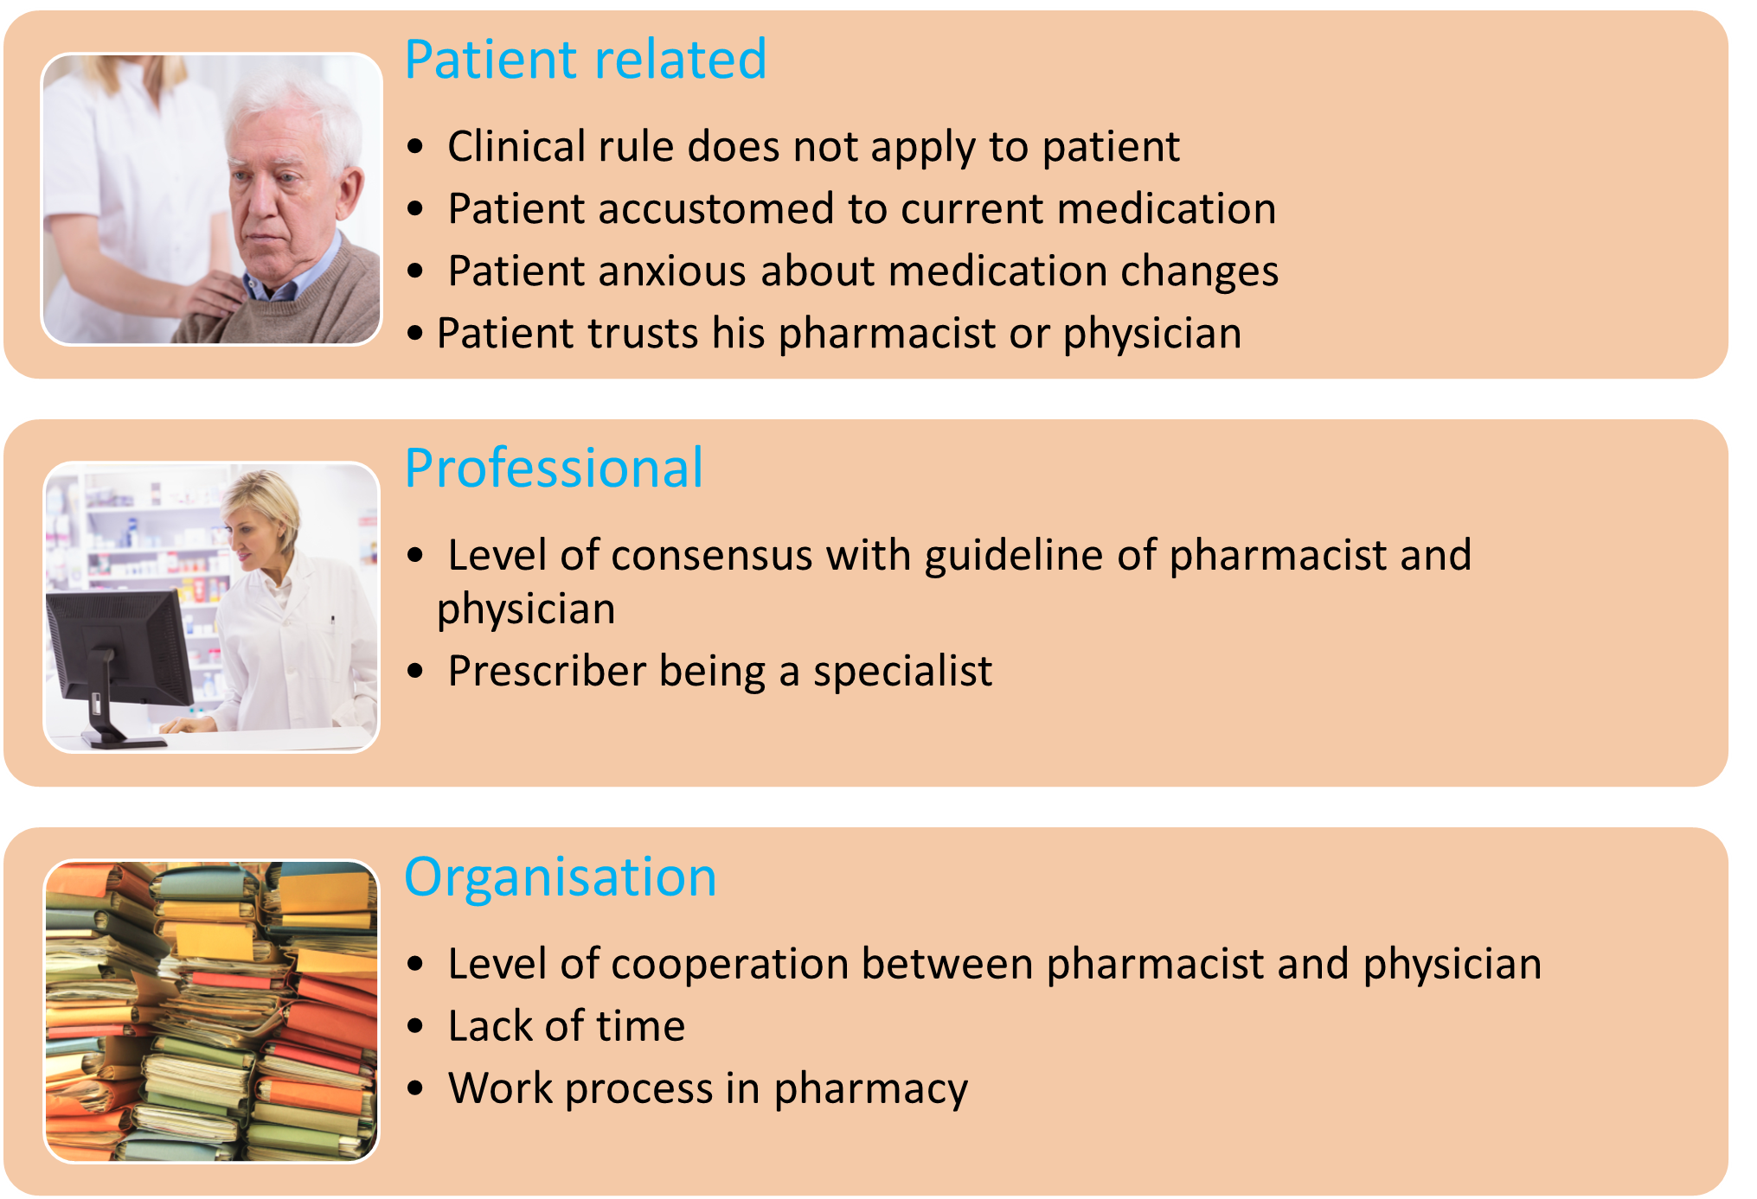
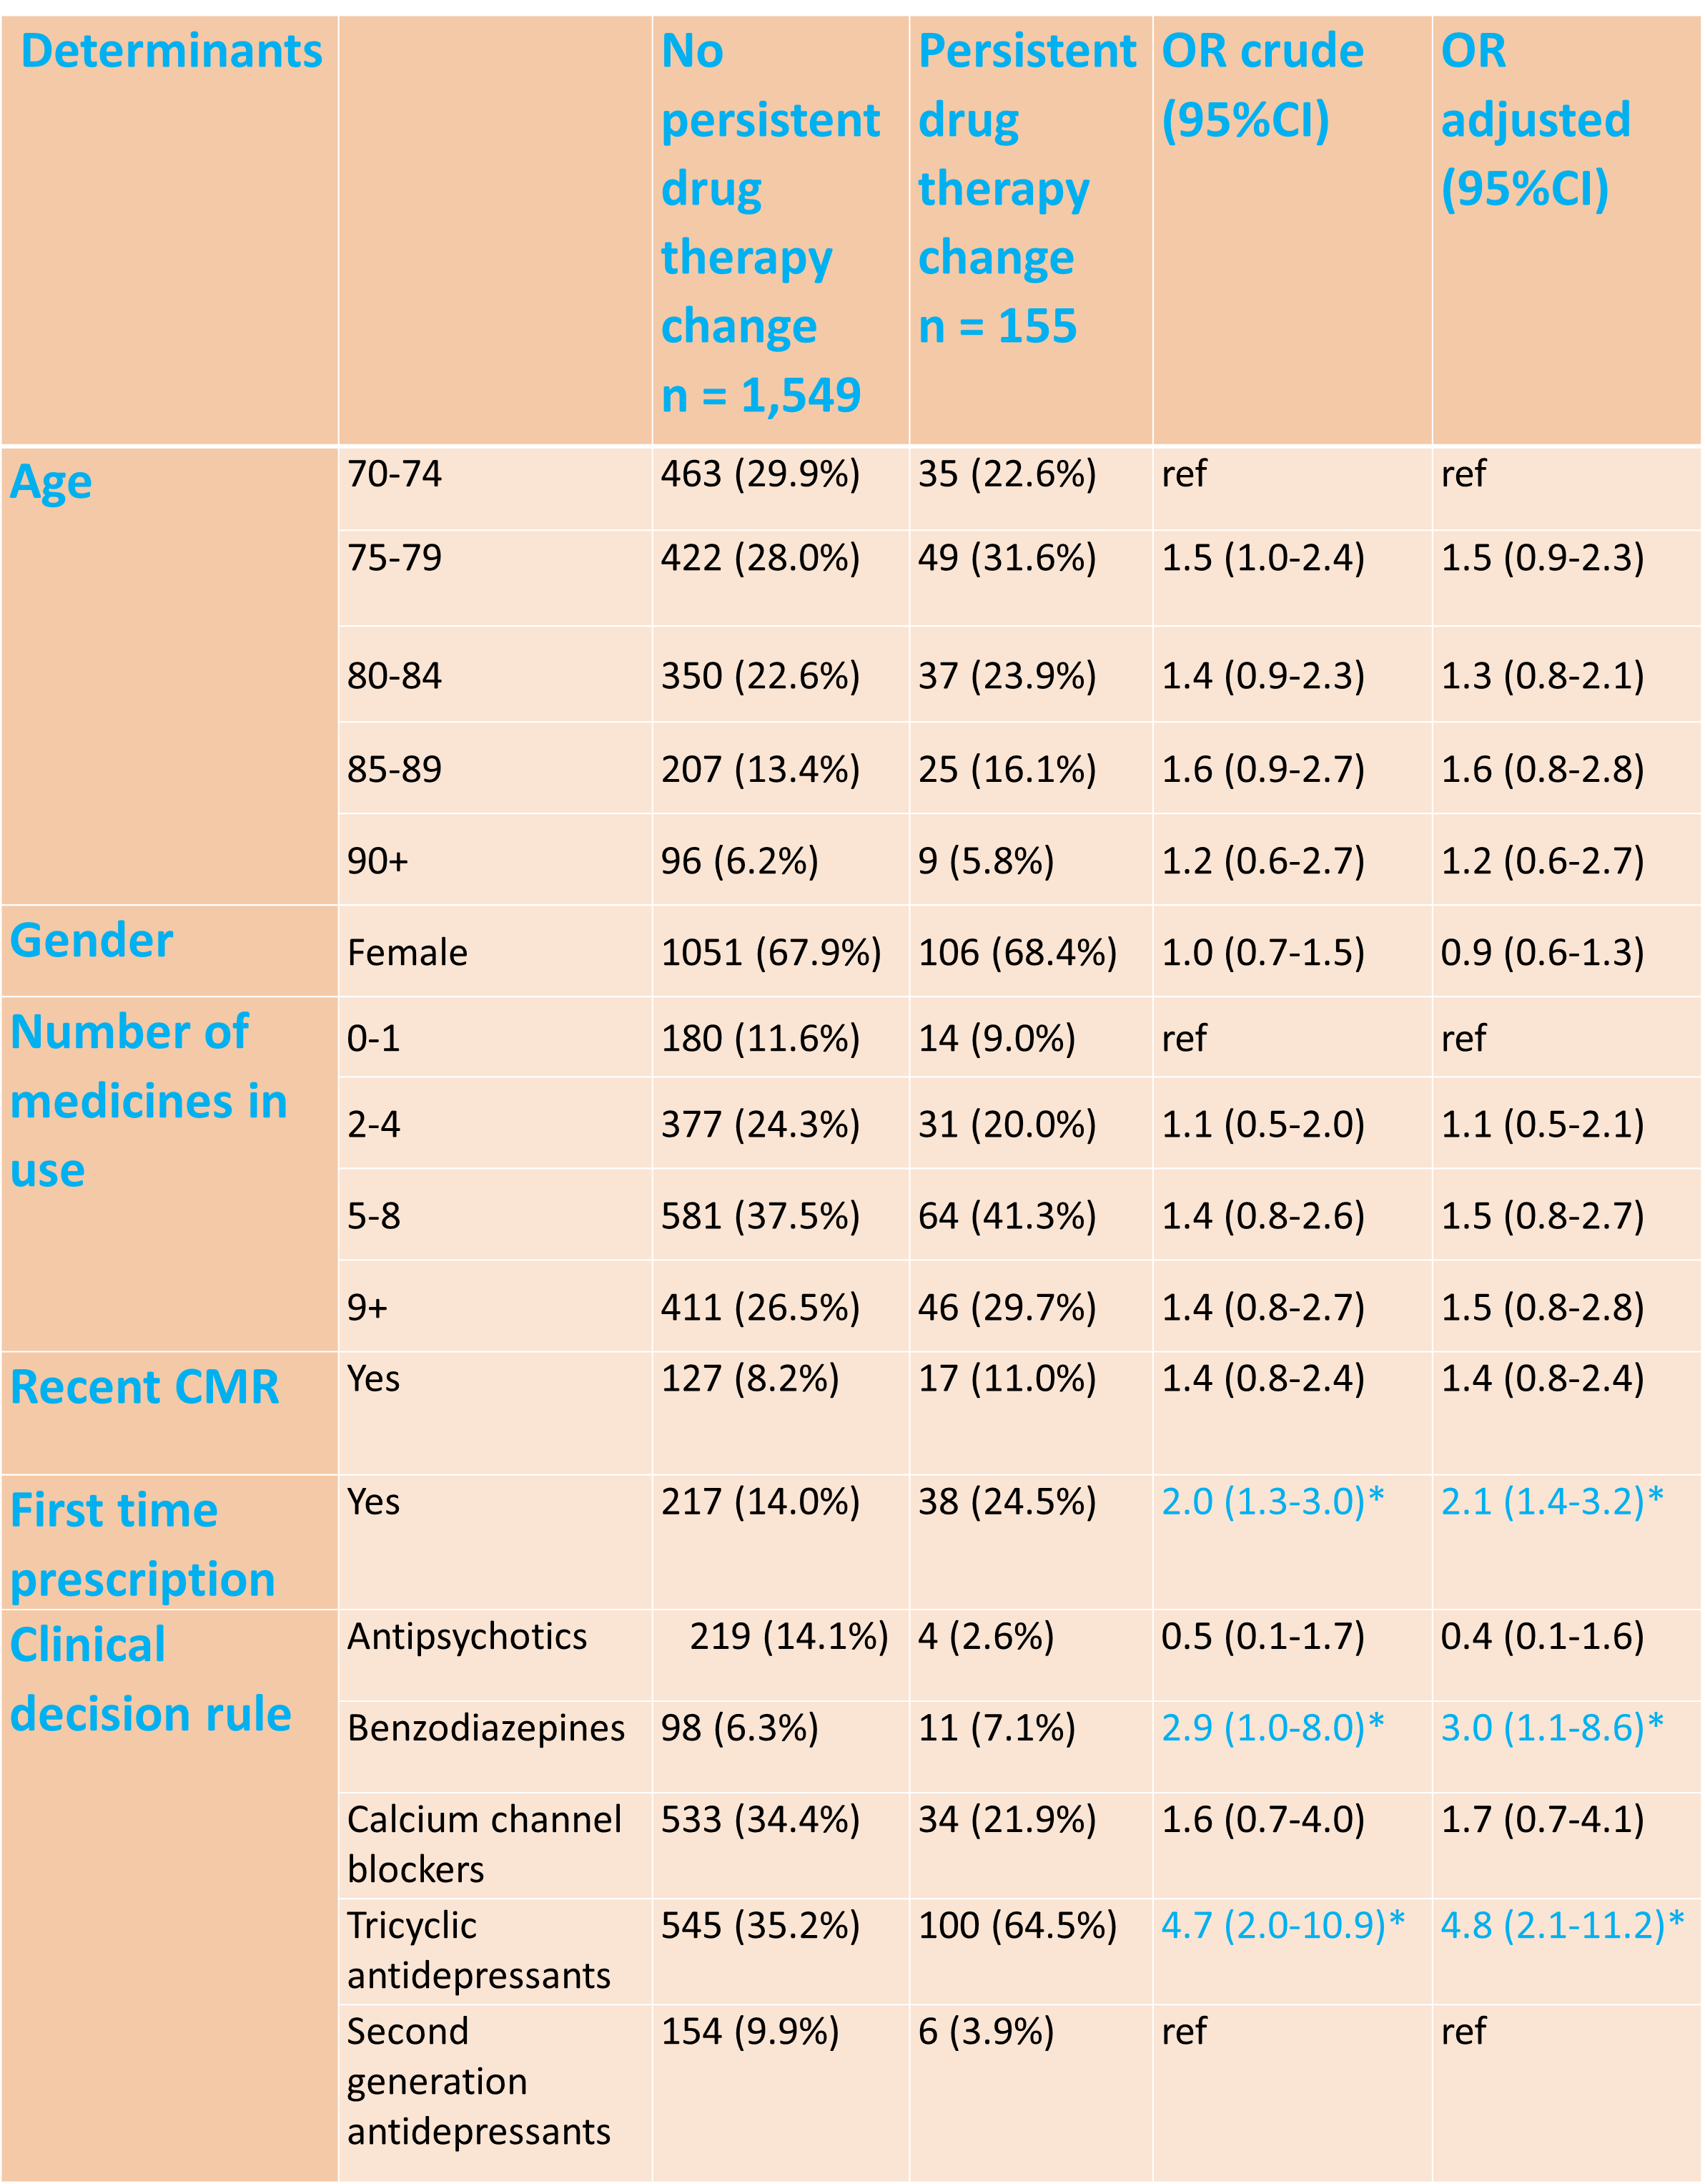
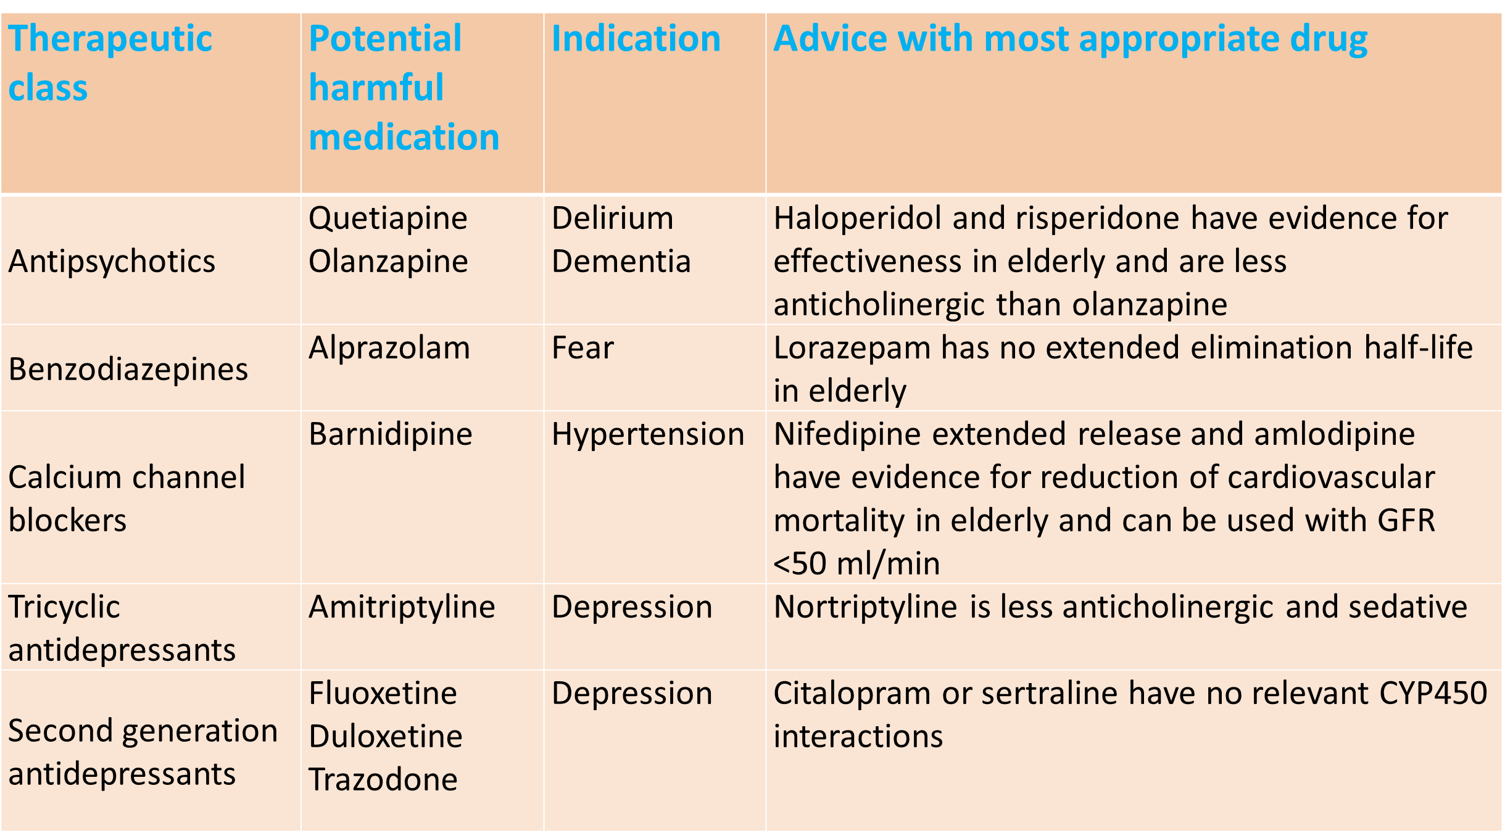
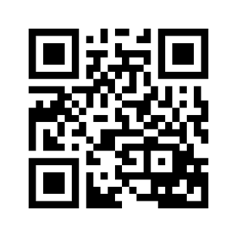
Reducing inappropriate drug use in elderly patients by use of clinical decision support in the community pharmacy: a mixed-methods evaluation of determinants of drug therapy changes
Linda Mulder-Wildemors¹, Mette Heringa^{1,2}, Annemieke Floor-Schreudering^{1,2}, Paul Jansen³, Petra Hoogland⁴, Sanne Verdoorn^{1,2}, Henk-Frans Kwint^{1,2}, Marcel Bouvy^{1,2}
¹ SIR Institute for Pharmacy Practice and Policy, Leiden, The Netherlands; ² Universiteit Utrecht, Utrecht, The Netherlands; ³ Expertisecentrum PHarmacotherapie bij OudeRen (Ephor), The Netherlands; ⁴ Nederlandse Service Apotheek Beheer B.V, ’s-Hertogenbosch, The Netherlands
Background
Older people are prone to drug related harm. The Dutch Expertisecentre PHarmacotherapy in Old persons (Ephor) has published evidence-based guidelines about the most appropriate drug per therapeutic class for vulnerable elderly. Clinical decision support systems (CDSSs) in community pharmacy can be a tool to implement these guidelines in order to improve appropriate prescribing in this population.
Purpose This study aims to investigate determinants of drug therapy changes based on CDSS alerts aimed at reducing inappropriate drug use in elderly patients.
Methods Five clinical decision rules based on the Ephor guidelines were incorporated in a web-based CDSS in 31 community pharmacies (franchisees of Service Apotheek) in February–April 2017: alprazolam for anxiety; amitriptyline for depression; barnidipine in hypertension; duloxetine, fluoxetine or trazodone in depression; quetiapine or olanzapine at delirium or dementia (Table 1). The CDSS generated alerts for patients >70 years in case of a prescription for one of the eight drugs. A descriptive analysis was performed based on the registered alert management and medication dispensing histories. Potential determinants of persistent drug therapy changes (changes detectable in the medication dispensing history up to six months after the alert) were analysed by logistic regression analysis. Ten participating community pharmacists were interviewed about the barriers and facilitators for alert management for drug therapy change. An inductive thematic analysis of the transcripts was performed.
Findings The pharmacists registered the management of 1810 of the 2589 generated alerts and 158 (8.7%) alerts resulted in a persistent drug therapy change. A logistic regression analysis showed that the drug triggering the alert and the type of prescription (first time versus repeat) were significantly associated with persistent drug therapy changes (Table 2). No association was found for age, gender and number of medicines in use and recent clinical medication review. Analysis of the interviews showed ten aspects which according to the pharmacists were associated with alert management leading to a drug therapy change. These aspects were clustered in patient related aspects, professional aspects and organization aspects (Figure 1).
Figure 1: Aspects influencing drug therapy changes
CI = confidence interval; OR = odds ratio; CMR = clinical medication review; * p ≤ 0,05
Table 1. Clinical rules
Table 2: Determinants of persistent drug therapy changes
Conclusion
In community pharmacy CDSS alerts to reduce inappropriate drug use in patients >70 years resulted in 8.7% of the cases in a persistent drug therapy change.
The drug leading to the alert and the type of prescription (first time) were associated with persistent drug therapy changes. According to community pharmacists patient-related, professional and organisation aspects influenced their alert management.
SIR Institute for Pharmacy
Practice and Policy
www.sirstevenshof.nl
PCNE 2019: 350
SIR Institute for Pharmacy Practice and Policy Theda Mansholtstraat 5b 2331 JE Leiden The Netherlands
l.mulder@sirstevenshof.nl

